Slide 1
Sentimental Analysis
IIMT COLLEGE OF ENGINEERING
Presentation on
Submitted By:
Alok Kumar
Nazim Khan
Shivani Kumari Gupta
Khushi Sharma
Project submitted to :
Mr. Anoop Kumar Awasthi

Slide 2
Content
Problem Statement
Introduction
What is sentimentality Analysis ?
Methodologies of Sentimental Analysis
Applications & uses
Advantages
Step by Step of SA

Slide 3
Problem Statement
You are provided with a dataset containing customer reviews of various products. Each review is labelled with either a positive or negative sentiment. Your task is to build a sentiment analysis model that can accurately classify the sentiment of a given review.

Slide 4
Introduction
Sentiment analysis is a technique used in natural language processing (NLP) to determine the emotional tone or attitude behind a piece of text. It involves classifying text into categories like positive, negative, or neutral, based on the sentiments expressed. By analysing reviews, social media posts, or any text data, sentiment analysis helps in understanding customer feedback, gauging public opinion, or monitoring brand perception. Machine learning models or rule-based approaches are commonly used to perform sentiment analysis. It is widely applied in fields like marketing, customer service, and politics to gain actionable insights.

Slide 5

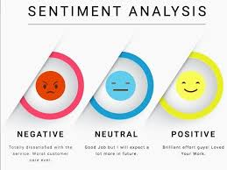

Slide 6
What does Sentimental Analysis means ?
Sentiment analysis (or opinion mining) is a natural language processing (NLP) technique used to determine the emotional tone behind a body of text. It involves identifying and extracting subjective information from text, such as opinions, attitudes, and emotions. The goal is to classify the sentiment expressed in the text as positive, negative, or neutral.

Slide 7
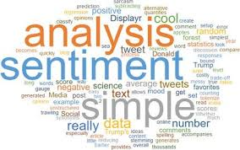
Why Sentimental Analysis ?

Slide 8
Sentimental Analysis can used as follows:
Social Media monitoring
Brand monitoring
Voice of Customer (VoC)
Customer service
Workforce analytics and voice of employee
Product analytics
Market research and analytics

Slide 9
Methodologies of Sentimental Analysis
There are various methodologies of Sentiment Analysis, few of them are given below:-
Rule-Based Approach: A rule-based system uses predefined sets of linguistic rules and sentiment lexicons to determine the polarity of text.
Machine Learning Approach: This involves training a model on labelled data (supervised learning) to classify text into sentiment categories.
Deep Learning Approach: Deep learning models, especially those using neural networks, have shown remarkable performance in sentiment analysis, especially for larger datasets or complex language structures.

Slide 10
Advantages
Real-time Insights: Sentiment analysis provides immediate feedback on public opinions or customer sentiments, helping businesses understand how their brand, product, or service is perceived. This real-time insight allows companies to respond quickly to changes in public sentiment.
Enhanced Customer Experience: By analyzing customer reviews, feedback, and social media mentions, businesses can identify areas of improvement and address customer pain points, improving overall customer satisfaction and loyalty.
Data-Driven Decision Making: Sentiment analysis helps organizations make informed decisions by analyzing large volumes of text data, such as customer reviews or social media posts, efficiently. This helps in refining marketing strategies, product development, and overall business strategy.

Slide 11
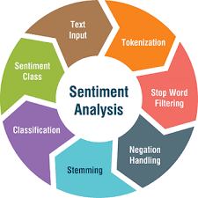
Step by Step of sentimental Analysis

Slide 12
Text Input
This is the raw textual data collected from various sources like social media, reviews, or surveys. It serves as the starting point for sentiment analysis, containing opinions or sentiments expressed by users.
Tokenization
In this step, the input text is broken down into smaller units called tokens, usually words or phrases. This helps in further analysis by making the text manageable for the model.

Slide 13
Stop Word Filtering
Common words such as "the," "is," and "and" that do not carry significant meaning are removed to focus on the more important words in the text.
Negation Handling
Special care is taken to ensure that negations (e.g., "not happy") are correctly understood in context, as they can reverse the sentiment of the phrase.

Slide 14
Stemming
Words are reduced to their root form (e.g., "running" to "run") to standardize variations of words, helping in accurate sentiment classification.
Classification
The pre-processed text is then passed through a sentiment classifier, which determines whether the sentiment is positive, negative, or neutral based on predefined models or algorithms.

Slide 15
Sentiment Class
the text is assigned a sentiment class based on the results of the classification step. This could range from categories like positive, negative, or neutral sentiment.

Slide 16
Conclusion
sentiment analysis provides valuable insights by extracting emotions and opinions from large volumes of textual data. It helps businesses understand customer feedback, track brand perception, and respond effectively to market trends. By using techniques like natural language processing and machine learning, it enables data-driven decision-making and improves customer experiences. As the technology advances, sentiment analysis will continue to grow in importance across industries, offering a deeper understanding of public sentiment and improving strategic outcomes.

Slide 17
References
www.datacamp.com
https://openai.com
www.slideshare.net
https://www.kdnuggets.com
And more

Slide 18
Thank You Any Query?

